Slide 1
West Area Juniors Competitions Review & Planning 2023 2024
Chairperson: Liz Powell ChairJuniorComps@westhockey.co.uk
Administrator: Jackie Stanley juniorcomps@westhockey.co.uk
EH Club Development Manager: Barbara Reynolds barbara.reynolds@englandhockey.co.uk
County Reps from: Avon, Cornwall, Devon, Dorset, Herefordshire, Gloucestershire, Somerset, Wiltshire, Jersey & Guernsey.
County Teams Coordinator: Helen Jefferies helen_jefferies@sky.com

Slide 2
West Junior League Results Boys 2022 2023

Slide 3
West Junior League Results Girls 2022 2023

Slide 4
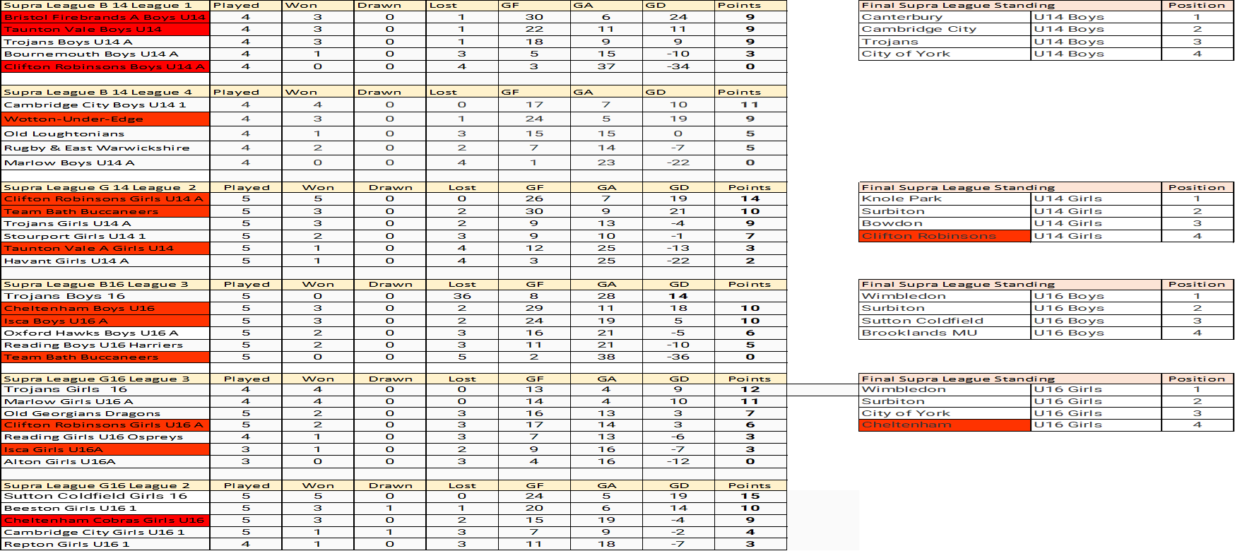
Supra League Results for West Junior Clubs 2023

Slide 5
Breakdown of the West Junior league 2022 2023
Total number of Junior clubs across the West = 88
Total number of clubs that entered into a west competition last season =31
Main reason walkovers were awarded
Unable to fill a team due to player availability.
Dates clash with School holidays and trips.
Team not able to travel .
Games Abandoned due to frozen pitches and clubs not able to rearrange the fixture.
Competition | Teams entered | Teams withdrawn | Games played Scores on GMS | Walk overs given | Abandoned games | Walk over Given by Who
Boys 14 T1 | 7 |  | 17 | 4 | 0 | Cheltenham 4
Boys 14 T1B | 3 |  | 2 | 1 | 0 | Cheltenham 1
Boys 14 T2 North | 5 |  | 18 | 1 | 1 | Marlborough 1
Boys 14 T3 | 5 |  | 10 | 9 | 1 | Thornbury 7 Westbury 1 stroud 1
Boys 16 T1 | 4 |  | 12 | 0 | 0 | 0
Boys 16 T2 South | 3 | ECVH | 9 | 0 | 1 | 0
Boys 16 T2 North | 5 | 2 Gloucester & Marlborough | 6 | 6 | 0 | Wotton 3 Bruton 1 Team Bath 2
Girls 14 T1 | 6 |  | 14 | 1 | 0 | Cheltenham 1
Girls 14 T1B | 3 |  | 6 | 3 | 0 | Cheltenham 3
Girls 14 T2 North | 7 |  | 30 | 11 | 1 | Bristol Firebrands 1 Gloucester 5 Devizes 2 Bruton 3
Girls 14 T3 | 6 |  | 29 | 1 | 0 | Team Bath 1
Girls 16 T1 | 7 |  | 20 | 1 | 0 | Plymouth 1
Girls 16 T1B | 4 |  | 1 | 5 | 0 | Taunton 2 Lansdown 2 Plymouth 1
Girls 16 T2 Central | 4 |  | 5 | 7 | 0 | Marlborough 4 Team Bath 1 Bruton 1 Devizes 1
Girls 16 T2 North | 5 |  | 12 | 8 | 0 | Cheltenham 2 Yate 3 OBs 3
Girls 16 T2 South | 4 | Truro | 7 | 2 | 0 | Ocean City 1 Truro 1
Girls 16 T3 | 5 | Firebrands | 14 | 0 | 1 | 0
Girls 18 T1 | 4 | OBs | 2 | 3 | 1 | Cirencester 3
 | 87 |  | 214 | 63 | 6

Slide 6
Junior Leagues U18 16 & 14 Tier 1
Tier 1 - U18
Play within league – remain at Area level
No Supra League at this age group
Travel across the whole Area
Tier 1 - U16
Direct entry to England Hockey and a nationally led league playing from September through to Supra League and knockout competitions for those who fail to progress to the Supra League. This replaces the Tier 1 Area / Supra League format and KO Championship that was run last year.
If you have any questions or queries regarding this, please don’t hesitate to contact junior.competitions@englandhockey.co.uk
Tier 1 - U14
U14 – Play in Area leagues pre-Christmas.
Post-Christmas - currently top 3 teams for both genders go through to Supra League to represent the West.
Remaining U14 / U16 teams form a Tier 1B with the potential of a couple of the stronger teams from Tier 2 joining them. This will increase travel after Christmas.

Slide 7
Guidance for Tiers
Tier | Guidelines
Tier 1 | A good team with talent players (NAGS/PC/AC) this should be where any club that is showing interest in becoming a talent centre should be competing (both genders and multiple age groups). Travel potentially across the whole West Area and possibly beyond.
Tier 2 | A competitive side who are looking for good opposition for competitive games. Travel more likely to be based around the north/south of the West Area. Travel could increase in the latter staged of the league.
Tier 3 | A newly formed junior side or section looking for their first games competitively (this could be a clubs 2’s 3’s 4’s depending on the size of the club etc. Local travel only with limited travel even at play off stages.
Tier 4 Counties to organise. | A growing junior section or new junior section. This is likely to be 7 a side or similar as they don’t have enough for a full team. Very informal learning environment. Probably no need for results to be recorded.

Slide 8
Before entering Clubs need to consider the following.
All members involved with their Junior league team to read the EH junior regulations thoroughly.
Clubs to enter the correct Tier for the standard of their team.
All matches in all competitions must be played on the scheduled date, or approved and agreed with a revised date by the West Committee. Games are to be played on the next available slip date or within 14 days of the original fixture
Team sheets for T1 & T2 will be required to be submitted on to GMS on the day of the fixture.
Teams will be required to supply a competent/level 1 umpire to fixtures unless informed in advance by the competition organiser.
Fixtures to be confirmed with the opposition no later than 14 days in advance of the fixture.
Clubs to be expected to travel to all away fixtures in their leagues.
Clubs to make sure they have the support for each team to host and travel to all fixtures.

Slide 9
What West Junior Leagues will be offered for 2023-2024
U16 Boys Tier 2 & U16 Girls Tier 2
U16 Boys Tier 3 & U16 Girls Tier 3
U14 Boys Tier 1 & U14 Girls Tier 1
U14 Boys Tier 2 & U14 Girls Tier 2
U14 Boys Tier 3 & U14 Girls Tier 3
All leagues will be subject to demand and will need to have a minimum of 4 entries to be viable.
Some age groups and tiers may vary in structure ( League, triangular fixtures ,1 day festivals ) depending on number of teams wishing to enter and their geographic locations.
The link below will take you to the entry form to fill in. This form is purely to indicate number of teams wishing to take part and to enable us to start planning. Once entries have been collected, the West Committee will contact you again to confirm structures and your participation https://forms.office.com/Pages/ResponsePage.aspx?id=-Mr8aL5rOkmKzhhCEJS1wxYcqdnBF61LuhywLcL0OQpUMzVRMk5DNk5UTkZGTkNBM1haV0Y2U1BRTy4u

Slide 10
When to enter into the West League
Tier 1 entries – Entries no later than Sunday 25 June 2023 Tier 1 Team fixture planning – End June to Mid Jul Tier 1 Team fixtures released – End of July Tier 1 fixtures start – 24 September
Tier 2 entries – Entries no later than Sunday 9 July 2023
Tier 2 Team fixture planning – Mid July - End July
Tier 2 Team fixtures released – Start of August
Tier 2 fixtures start – 24 September
Tier 3 Team entries – No later than Sunday 17 September 2023 Tier 3 Team fixture planning – Mid September Tier 3 Team fixtures released – Last week of September Tier 3 Fixtures start –15 October

Slide 11
West Clubs in2hockey results 2023
Boys U10: Clifton Robinsons – Cheltenham
Girls U10: Westbury – Team Bath
Boys U12: Clifton Robinsons – Cheltenham
Girls U12 : Isca - Team Bath
14 teams from across the West qualified into each competition last season.

Slide 12
Who leads what at County & West level for Junior Clubs
U8 / U10 / U12
County -Area led activity
U8, U10 and U12 stay at County -Area level and are run as festivals or leagues.
U10, top 2 teams from In2Hockey County -Area finals go to West Finals but no further.
U12 top 2 teams from In2Hockey County finals go to West Finals. Top team from West Finals go to National Finals.
County -Area led activity for Tier 4 if there is a demand
U14 / U16 / U18
Area lead/Junior league
Area led activity for Tiers 1, 2 and 3 where Viable.
West Area finals U10 (21st April at Millfield )
West Area finals U12 ( 14th April at Clifton College)

Slide 13
West Sub Areas offer for Junior competition
 | Number of Clubs with a Junior sections | Offer Competition | U8 | U10 | U12 | U14 | U16 | Other
Avon | 19 | √ | √ | √ | √ | √
Cornwall | 9 | √ | √ | √ | √ | √ | √ | √
Devon | 18
Dorset | 7 | √ | √ | √ | √ | √ | √ | √
Gloucestershire | 8 | √ | √ | √ | √
Herefordshire | 0 | x | x | x | x | x | x | x
Somerset | 12 | √ | √ | √ | √ | √
Wiltshire | 8 | √ | √ | √ | √ | √ | √ | √

Slide 14
West Clubs Indoor results 2023-2024
Club Boys 16: Wotton Under Edge – Isca
Club Boys 18: Clifton Robinson – Team Bath
Club Girls 16: Lansdown – Cheltenham
Club Girls 18: Cheltenham - Isca
This season saw club's pull-out of the indoor competition in the week running up to the competition due to being unable to field a team.

Slide 15
West Clubs Indoor Dates 2023-2024
Club Boys U16 indoor: Sunday 3 December 2023 at Wellington School
Club Boys U18 indoor: Sunday 3 December 2023 at Wellington School
Club Girls U16 indoor: Sunday 3 December 2023 at Cheltenham Ladies College
Club Girls U18 indoor: Sunday 3 December 2023 at Cheltenham Ladies College
Extra date booked if need: Sunday 10th December at Cheltenham Ladies College.
Due to the continuing losses made each year at all West Indoor competitions it has been decide that the Clubs who qualify for each final will need to bear the costs occurred for pitch hire and umpires. Invoices will be sent out once costs have been finalised and Clubs confirmed.

Slide 16
Anything I have missed ?
West umpires required for indoor competition only.
Winners Pin Badges will be awarded as below .
Boy and Girl 11 aside competitions : Winners & Runner up .
Boy and Girl IN2 competitions : Winners, Runner up & 3rd Place
Boy and Girl Indoor competitions : Winners & Runner up.

